Slide 1
Understanding Kubernetes
[Session 2] Kubernetes Introduction

Slide 2
Agenda
Kubernetes Control Loop & Objects
Object Management
Imperative
Declarative
Kubernetes Objects
PODs
ReplicaSets
Deployments
Namespaces
Jobs
CronJobs
Services
Services Cluster IP
Services NodePort
Services - Loadbalancer
Hands On

Slide 3
Kubernetes Control Loop & Objects

Slide 4
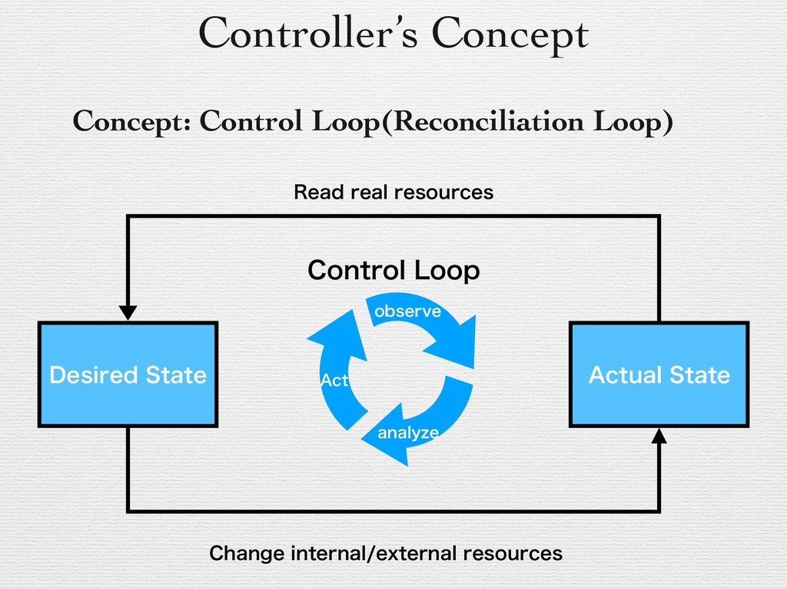
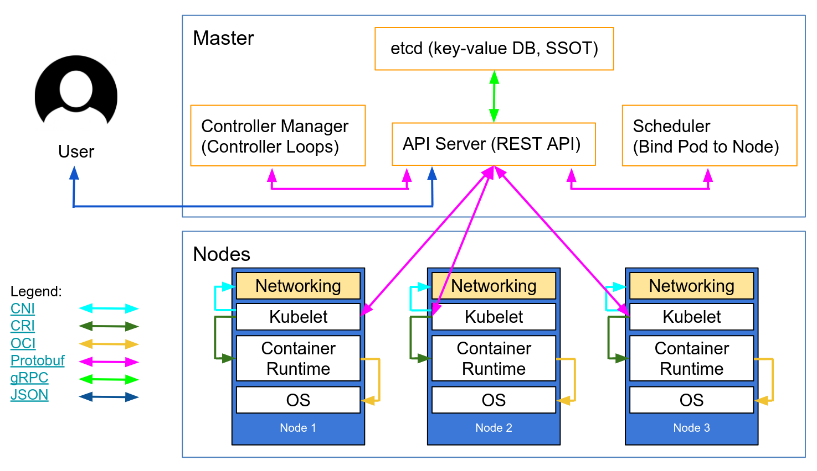
K8s Control Loops: Current state vs Desired state
As a key principle of its design, Kubernetes uses lots of controllers that each manage a particular aspect of cluster state.
A controller tracks at least one Kubernetes resource type Object.
These objects have a spec field that represents the desired state.
The controller(s) for that resource are responsible for making the current state come closer to that desired state.
Notes:
https://www.researchgate.net/figure/Kubernetes-architecture_fig1_320248964
https://kubernetes.io/blog/2018/07/18/11-ways-not-to-get-hacked/
https://kubernetes.io/docs/concepts/architecture/controller/

Slide 5
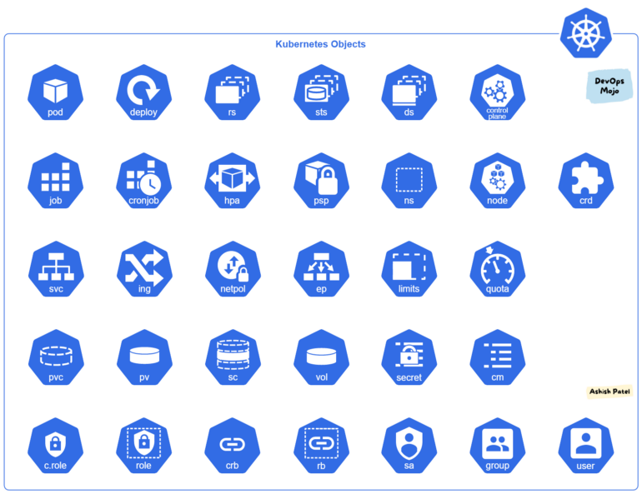
Kubernetes Objects
Objects are persistent entities in etcd, to represent the state of cluster like pod, deployment/pv etc..
It is a "record of intent" created in k8s when user apply config like create a pod/deployment/job etc.
Kubernetes APIs to create, modify, or delete object
When using kubectl command-line interface, the CLI makes the necessary Kubernetes API calls.
Once create the object, the Kubernetes system will constantly work to ensure that object exists.
desired state: By creating an object, effectively telling the Kubernetes system what cluster's workload to look like.
Notes:
https://kubernetes.io/docs/concepts/overview/working-with-objects/kubernetes-objects/
https://medium.com/devops-mojo/kubernetes-objects-resources-overview-introduction-understanding-kubernetes-objects-24d7b47bb018

Slide 6
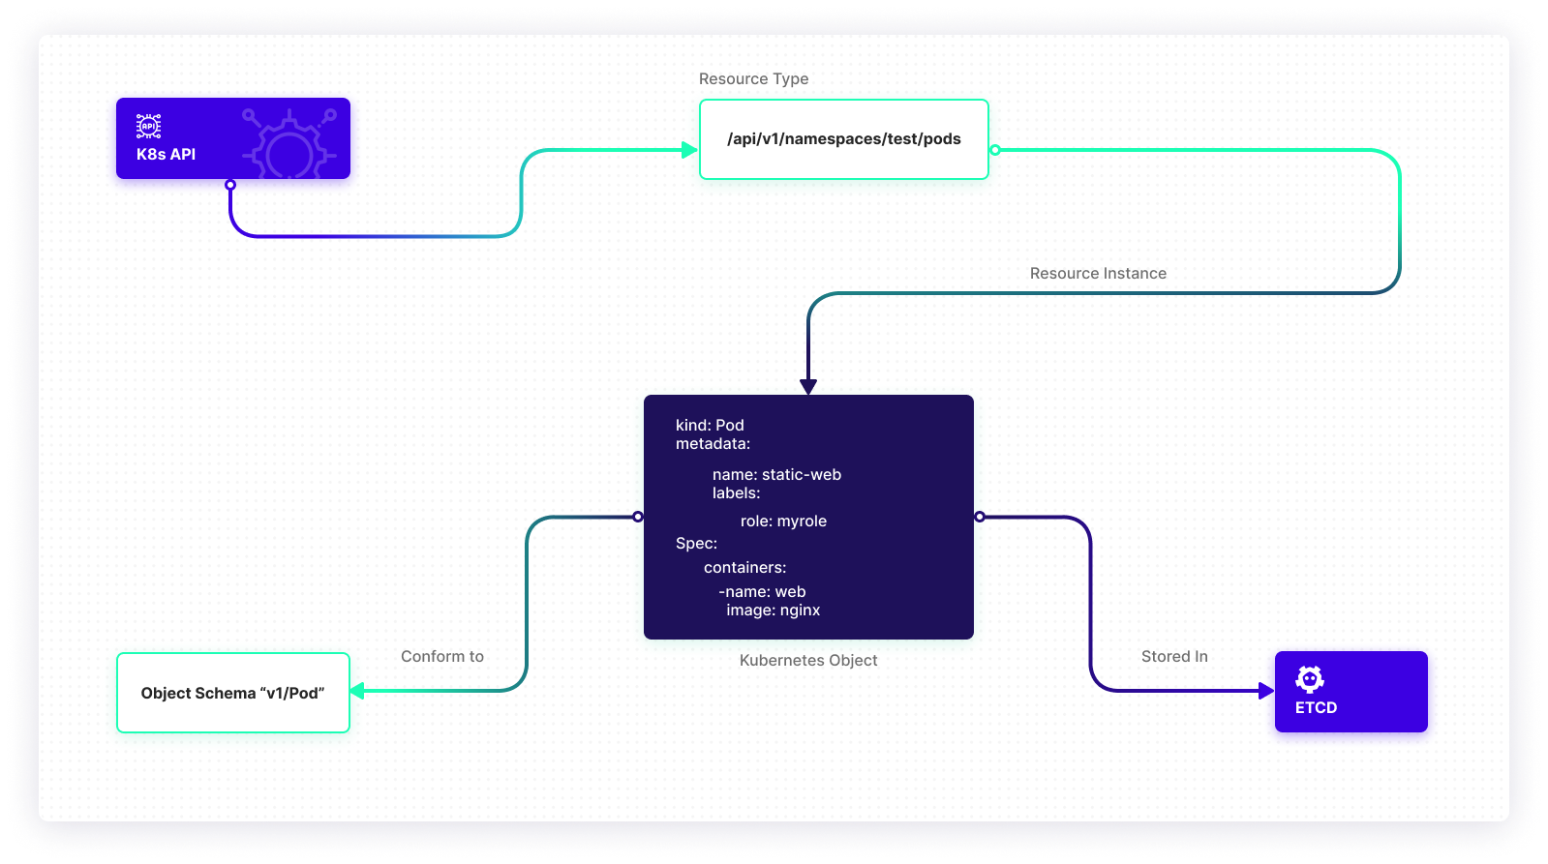
Object Spec and Status
Almost every Kubernetes object includes two nested object fields that govern the object's configuration: the object spec and the object status.
spec:
When create the object, need to providing a description of the characteristics we want the resource to have: its desired state.
status:
Describes the current state of the object, supplied and updated by the Kubernetes system and its components.
The Kubernetes control plane continually and actively manages every object's actual state to match the desired state you supplied.

Slide 7
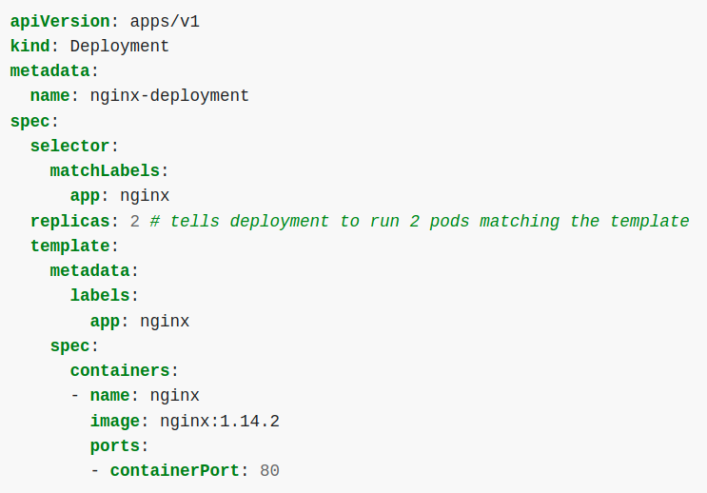
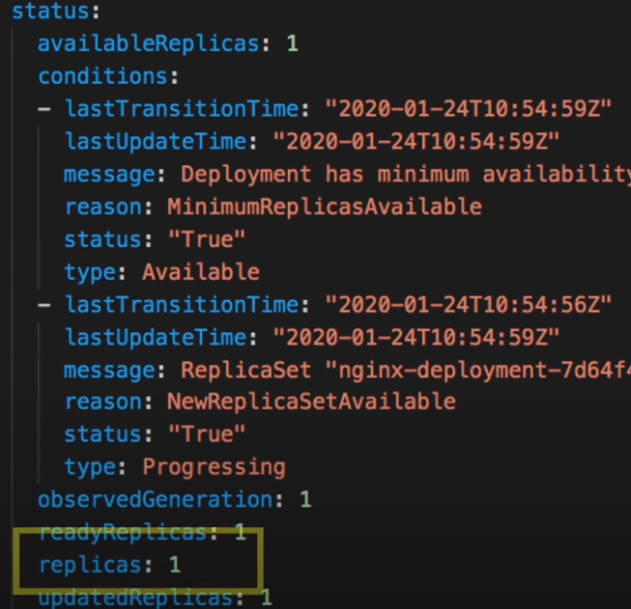
Sample Kubernetes yaml file for object
User provide below info:
meta info like name, labels etc.
spec that describes its desired state,
K8s control plan and other components maintain object status and current state of Object:
3 parts of config file:
Metadata
Name
Labels
----
Specification (configuration)
Replicaset
Matchlabels
Containers template
Image
Ports
Env etc.
Status (generated by kubernetes)
Status is maintained in etcd
Desired state
Actual state
Controller try to make same actual to desired state which make it self healing
Notes:
https://www.youtube.com/watch?v=qmDzcu5uY1I

Slide 8
K8s Object Management

Slide 9
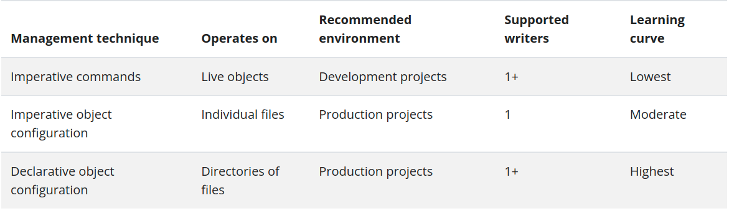
Kubernetes Object management
The kubectl tool supports three kinds of object management:
Imperative commands
Imperative object configuration
Declarative object configuration
Notes:
https://medium.com/payscale-tech/imperative-vs-declarative-a-kubernetes-tutorial-4be66c5d8914

Slide 10
Imperative Commands
Kubernetes objects can quickly be created, updated, and deleted directly using imperative commands built into the kubectl command-line tool.
When using imperative commands, a user operates directly on live objects in a cluster.
Create Object:
kubectl create deployment nginx --image nginx
Update/edit Object:
kubectl set image deployment/nginx-deployment nginx=nginx:1.16.1
OR
kubectl edit deployment/nginx
Delete object:
kubectl delete deployment nginx
View object:
Get, describe, logs
Kubectl cheat sheet link -----
https://jamesdefabia.github.io/docs/user-guide/kubectl/kubectl/
Notes:
https://kubernetes.io/docs/tasks/manage-kubernetes-objects/imperative-command/
https://kubernetes.io/docs/concepts/workloads/controllers/deployment/

Slide 11
Imperative object configuration
Kubectl command specifies the operation (create, replace, etc.), optional flags and at least one file name.
The file specified must contain a full definition of the object in YAML or JSON format.
Create the objects defined in a configuration file:
kubectl create -f pod-test.yaml
Delete the objects defined in two configuration files:
kubectl delete -f pod-test.yaml
Update the objects defined in a configuration file by overwriting the live configuration:
kubectl replace -f pod-test-replace.yaml
///first get current object by
/// kubectl get po nginx -o yaml > nginx-replace.yaml
/// edit this file and run above cmd
Notes:
https://kubernetes.io/docs/tasks/manage-kubernetes-objects/imperative-command/
https://kubernetes.io/docs/concepts/workloads/controllers/deployment/

Slide 12
Declarative object configuration
Kubernetes objects can be created, updated, and deleted by storing multiple object configuration files in a directory and using kubectl apply to recursively create and update those objects as needed.
This method retains writes made to live objects without merging the changes back into the object configuration files. kubectl diff also gives you a preview of what changes apply will make.
Sets fields that appear in the configuration file in the live configuration.
Clears fields removed from the configuration file in the live configuration.
Create/update the objects defined in a configuration dir:
kubectl apply -f declarative/
Print live config for annotations:
kubectl get deployment nginx-deployment -o yaml
Edit by imperative:
kubectl scale deployment/nginx-deployment --replicas=2
Check for annotation:
kubectl get deployment nginx-deployment -o yaml
Run kubectl diff to print the object that will be created:
kubectl diff -f <directory>/
Update for add/remove fields:
kubectl apply -f deploy-declative-updated.yaml
Note: Add the -R flag to recursively process directories.
Notes:
https://kubernetes.io/docs/tasks/manage-kubernetes-objects/declarative-config/

Slide 13
K8s Objects

Slide 14
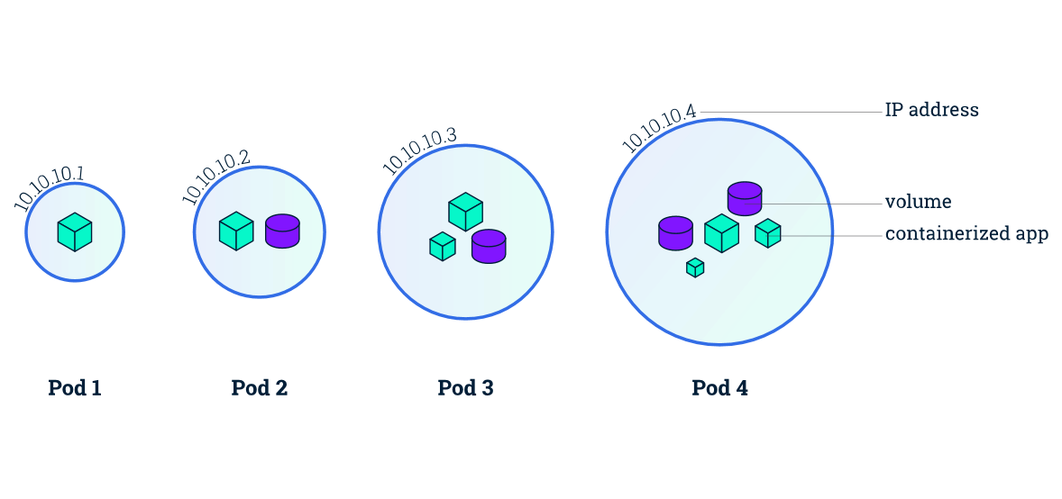
POD
Pod is the basic unit of work and the smallest deployable unit of computing that you can create and manage in Kubernetes.
Pod is a group of one or more containers, with shared storage and network resources, and a specification for how to run the containers.
Pod is a thin wrapper around one or more containers.
Once the scheduler assigns a Pod to a Node, the kubelet starts creating containers for that Pod using a container runtime.
Notes:
https://kubernetes.io/docs/concepts/workloads/pods/pod-lifecycle/

Slide 15

Component interaction flow (Pod create)
kubectl run nginx --image=nginx
kubectl or any other API client submits the Pod spec to the API server.
The API server writes the Pod object to the etcd data store. Once the write is successful, an acknowledgment is sent back to API server and to the client.
The kube-scheduler (via its watcher) sees that a new Pod object is created on API server but is not bound to any node.
kube-scheduler assigns a node to the pod and updates the API server.
This change is then propagated to the etcd data store. The API server also reflects this node assignment on its Pod object.
Kubelet on every node also runs watchers who keep watching API server. Kubelet on the destination node sees that a new Pod is assigned to it.
Kubelet starts the pod on its node by calling Docker and updates the container state back to the API server.
The API server update the pod state into etcd.
Once etcd sends the acknowledgment of a successful write, the API server sends an acknowledgment back to kubelet indicating that the event is accepted.
Api server
Kube proxy
kubelet
etcd
runtime
Scheduler
Kube proxy
kubelet
Controller Manager
runtime

Slide 16
POD Operations
Create a POD:
kubectl apply -f pod-test.yaml
Get pod:
kubectl get po -o wide
Describe pod:
kubectl describe po nginx
Exec cmds:
kubectl exec -it nginx sh
Sample Pod yaml link:

Slide 17
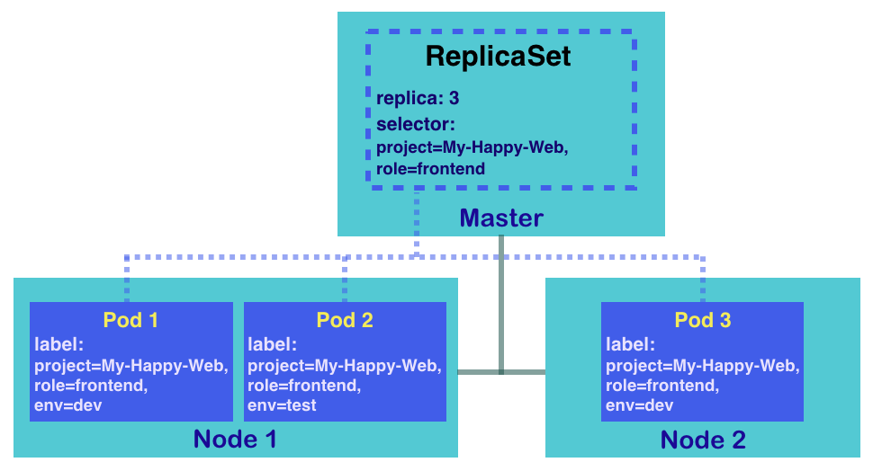
ReplicaSet
ReplicaSet’s purpose is to maintain a stable set of replica Pods (Identical Pods) running at any given time.
ReplicaSet ensures a defined number of pods are always running.
Kubernetes supports self-healing applications through ReplicaSets and Replication Controllers.
The replication controller helps in ensuring that a POD is re-created automatically when the application within the POD crashes. It helps in ensuring enough replicas of the application are running at all times.
Usually, ReplicaSet should not created directly. However, Deployment is a higher-level concept that manages ReplicaSets and provides declarative updates to Pods.
It is recommend using Deployments instead of directly using ReplicaSets.
apiVersion: apps/v1
kind: ReplicaSet
metadata:
name: frontend
labels:
app: guestbook
tier: frontend
spec:
# modify replicas according to your case
replicas: 3
selector:
matchLabels:
tier: frontend
template:
metadata:
labels:
tier: frontend
spec:
containers:
- name: php-redis
image: gcr.io/google_samples/gb-frontend:v3

Slide 18
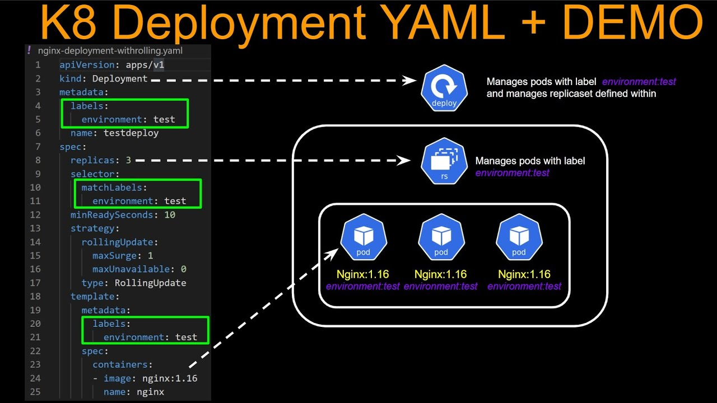
Deployment
Deployment provides declarative updates for Pods (Identical Pods) and ReplicaSets.
Deployment creates a management object one level higher than a replica set, and enables you to deploy and manage updates for pods in a cluster.
Deployment handles the ReplicaSet, it gets automatically created with Deployment.
Deployment is the most common way to get your app on Kubernetes.
You describe a desired state in a Deployment, and the Deployment Controller changes the actual state to the desired state at a controlled rate.
Deployment has details of how to roll out (or roll back) across versions of your application.
Notes:
https://kubernetes.io/docs/concepts/workloads/controllers/deployment/
https://medium.com/avmconsulting-blog/deployment-types-in-kubernetes-14b70ca7ef93

Slide 19
Deployment use Case
The following are typical use cases for Deployments:
Create a Deployment to rollout a ReplicaSet. The ReplicaSet creates Pods in the background. Check the status of the rollout to see if it succeeds or not.
Declare the new state of the Pods by updating the PodTemplateSpec of the Deployment. A new ReplicaSet is created and the Deployment manages moving the Pods from the old ReplicaSet to the new one at a controlled rate. Each new ReplicaSet updates the revision of the Deployment.
Rollback to an earlier Deployment revision if the current state of the Deployment is not stable. Each rollback updates the revision of the Deployment.
Scale up the Deployment to facilitate more load.
Pause the rollout of a Deployment to apply multiple fixes to its PodTemplateSpec and then resume it to start a new rollout.
Use the status of the Deployment as an indicator that a rollout has stuck.
Clean up older ReplicaSets that you don't need anymore.

Slide 20
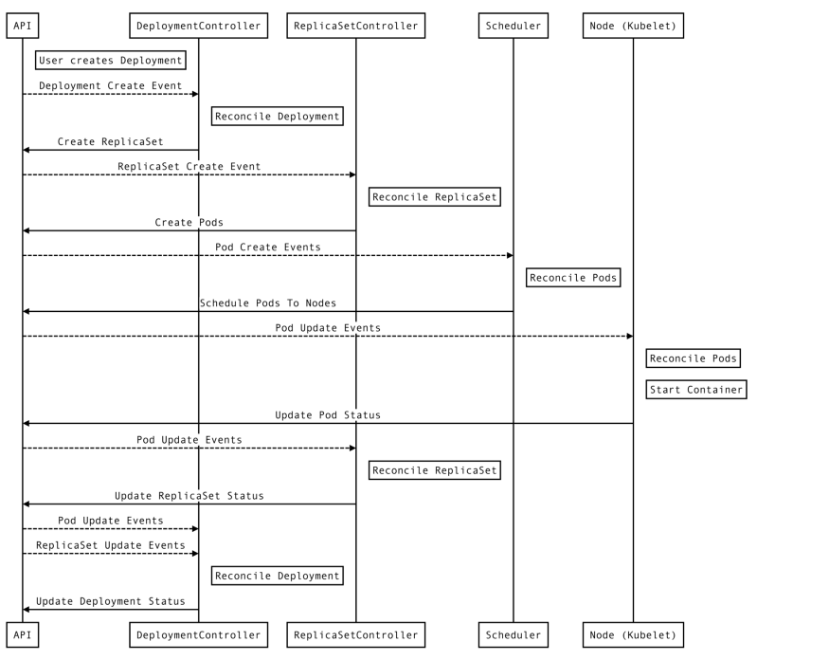
Deployment flow
Create Deployment:
kubectl apply -f pod-deployment.yaml
To see the ReplicaSet (rs) created by the Deployment, run
kubectl get rs

Slide 21
Roll out and roll over
RollOut:
Each time a new Deployment is observed by the Deployment controller, a ReplicaSet is created to bring up the desired Pods.
If the Deployment is updated, the existing ReplicaSet that controls Pods whose labels match .spec.selector but whose template does not match .spec.template are scaled down.
Eventually, the new ReplicaSet is scaled to .spec.replicas and all old ReplicaSets is scaled to 0.
Roll over:
Update a Deployment while an existing rollout is in progress
Deployment creates a new ReplicaSet as per the update and start scaling that up
Rolls over the ReplicaSet that it was scaling up previously -- it will add it to its list of old ReplicaSets and start scaling it down.
RollOut new version
kubectl set image deployment/nginx-deployment nginx=nginx:1.16.1
Rollout status:
kubectl rollout status deployment/nginx-deployment
Notes:
https://www.bluematador.com/blog/kubernetes-deployments-rolling-update-configuration

Slide 22
RollBack
Rollback to old version of deployment.
K8s maintain history of rollout.
Rollback can be done to previous revision or a particular revision as well
Rollout history:
kubectl rollout history deployment/nginx-deployment
Reviosn details:
kubectl rollout history deployment/nginx-deployment --revision=2
Rollback:
Rollback to previous version:
kubectl rollout undo deployment/nginx-deployment
Rollback to specicfc revision:
kubectl rollout undo deployment/nginx-deployment --to-revision=2

Slide 23
Scaling a Deployment
When traffic increases, we will need to scale the application to keep up with user demand.
Scaling is accomplished by changing the number of replicas in a Deployment
kubectl scale deployment/nginx-deployment --replicas=10
Autoscaling:
We can setup an autoscaler for Deployment and choose the minimum and maximum number of Pods you want to run based on the CPU utilization of your existing Pods.
kubectl autoscale deployment/nginx-deployment --min=10 --max=15 --cpu-percent=80
Notes:
https://kubecloud.io/setting-up-kubernetes-visualization-of-a-cluster-96826433fc64

Slide 24
Pausing and Resuming a rollout of a Deployment:
For multiple updates, pause rollouts for that Deployment.
When you're ready to apply those changes, resume rollouts for the Deployment.
This approach allows to apply multiple fixes in between pausing and resuming without triggering unnecessary rollouts.
Pause a rollout:
kubectl rollout pause deployment/nginx-deployment
Update rollout:
kubectl set image deployment/nginx-deployment nginx=nginx:1.16.1
Check no RS created:
kubectl rollout history deployment/nginx-deployment
kubectl get rs
Set one more changes in rollout:
kubectl set resources deployment/nginx-deployment -c=nginx --limits=cpu=200m,memory=512Mi
Resume rollout:
kubectl rollout resume deployment/nginx-deployment
Watch RS:
kubectl get rs -w

Slide 25
JOB :
apiVersion: batch/v1
kind: Job
metadata:
name: pi-with-timeout
spec:
backoffLimit: 5
activeDeadlineSeconds: 100
ttlSecondsAfterFinished: 100
template:
spec:
containers:
- name: pi
image: perl
command: ["perl", "-Mbignum=bpi", "-wle", "print bpi(2000)"]
restartPolicy: Never
Job runs pods that perform a completable task.
Job creates one or more Pods and will continue to retry execution of the Pods until a specified number of them successfully terminate.
Job ensures a pod properly runs to completion.
Deleting a Job will clean up the Pods it created. Suspending a Job will delete its active Pods until the Job is resumed again.
A controller for Jobs tracks Job objects (to discover new work) and Pod objects (to run the Jobs, and then to see when the work is finished).

Slide 26
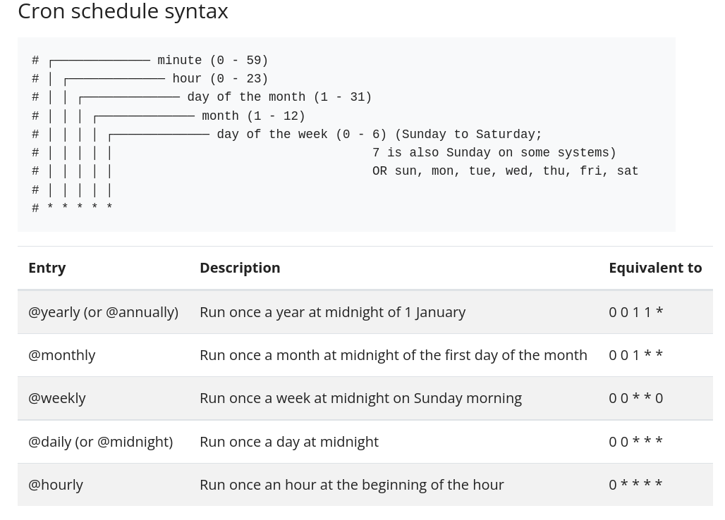
Cron Job:
CronJob creates Jobs on a repeating schedule.
One CronJob object is like one line of a crontab (cron table) file. It runs a job periodically on a given schedule, written in Cron format.
CronJobs are meant for performing regular scheduled actions such as backups, report generation, and so on.
Each of those tasks should be configured to recur indefinitely (for example: once a day / week / month); you can define the point in time within that interval when the job should start.
apiVersion: batch/v1
kind: CronJob
metadata:
name: hello
spec:
schedule: "* * * * *"
jobTemplate:
spec:
template:
spec:
containers:
- name: hello
image: busybox:1.28
imagePullPolicy: IfNotPresent
command:
- /bin/sh
- -c
- date; echo Hello from the Kubernetes cluster
restartPolicy: OnFailure

Slide 27
Namespace :
Namespaces provides a mechanism for isolating groups of resources within a single cluster.
Names of resources need to be unique within a namespace, but not across namespaces.
Namespace-based scoping is applicable only for namespaced objects (e.g. Deployments, Services, etc) and not for cluster-wide objects (e.g. StorageClass, Nodes, PersistentVolumes, etc).
Namespaces enable organizing resources into non-overlapping groups (for example, per tenant, per environment, per project, per team)
Not All Objects are in a Namespace:
Most Kubernetes resources (e.g. pods, services, replication controllers, and others) are in some namespaces. However namespace resources are not themselves in a namespace. And low-level resources, such as nodes and persistentVolumes, are not in any namespace.
To see which Kubernetes resources are and aren't in a namespace:
# In a namespace
kubectl api-resources --namespaced=true
# Not in a namespace
kubectl api-resources --namespaced=false

Slide 28
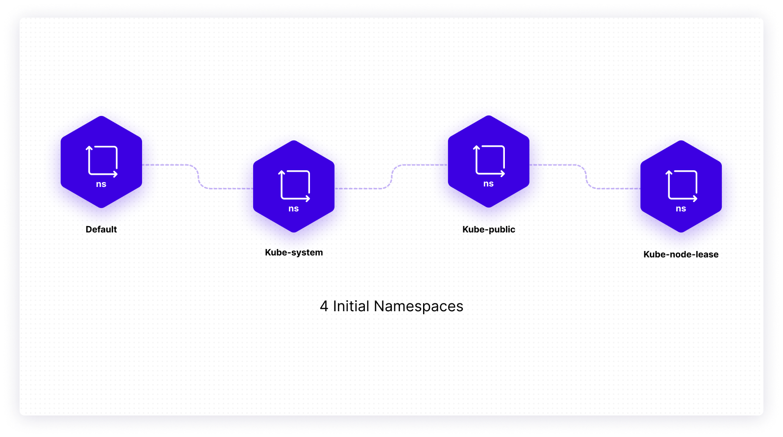
Four initial namespaces present:
default: where your resources you create would be deployed
kube-system: where the objects created by the Kubernetes system would be stored
kube-public: where the resources that should be visible and publicly readable should be stored
kube-node-lease: where Node Lease objects are stored.
Notes:
https://www.containiq.com/post/kubernetes-objects

Slide 29
Services

Slide 30
Service:
Why:
Kubernetes Pods are created and destroyed to match the state of your cluster. Pods are nonpermanent resources.
If you use a Deployment to run your app, it can create and destroy Pods dynamically.
SO IP will change each time pod restart.
What:
Service is used to expose an application deployed on a set of pods using a single endpoint. i.e. It maps a fixed IP address to a logical group of pods.
Service provides stable networking for pods by bringing stable IP addresses and DNS names, and provide a way to Kubernetes to configuring a proxy to forward traffic to a set of pods.
Service enables communication between nodes, pods, and users of app, both internal and external, to the cluster. Service also provides load balancing when you have Pod replicas.
There are four types of Kubernetes services — ClusterIP, NodePort, LoadBalancer and ExternalName
The set of Pods targeted by a Service is usually determined by a selector.
apiVersion: v1
kind: Service
metadata:
name: my-service
spec:
selector:
app: MyApp
ports:
- protocol: TCP
port: 80
targetPort: 9376
Above specification creates a new Service object named "my-service", which targets TCP port 9376 on any Pod with the app=MyApp label.
Notes:
https://medium.com/devops-mojo/kubernetes-objects-resources-overview-introduction-understanding-kubernetes-objects-24d7b47bb018

Slide 31
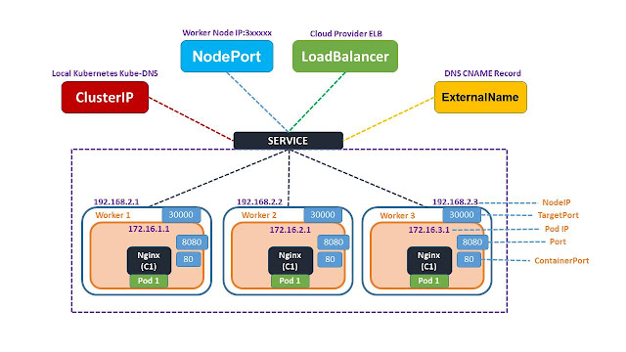
Types of Kubernetes Services
These services can be used in different ways based on the types.
ClusterIP (default) – Exposes the Service on an internal IP in the cluster. This type makes the Service only reachable from within the cluster.
NodePort – Exposes the Service on the same port of each selected Node in the cluster using NAT. Makes a Service accessible from outside the cluster using <NodeIP>:<NodePort>. Superset of ClusterIP.
LoadBalancer – Creates an external load balancer in the current cloud (if supported) and assigns a fixed, external IP to the Service. Superset of NodePort.
ExternalName – Exposes the Service using an arbitrary name (specified by externalName in the spec) by returning a CNAME record with the name.
Notes:
https://medium.com/devops-mojo/kubernetes-objects-resources-overview-introduction-understanding-kubernetes-objects-24d7b47bb018

Slide 32
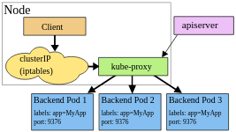
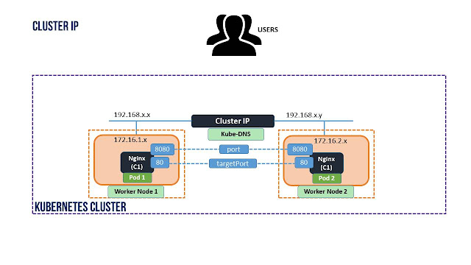
Service: Cluster IP
Cluster IP is the default one used only for internal communication within the cluster through service, not to the external traffic.
CoreDNS, watches the Kubernetes API for new Services and creates a set of DNS records for each one. Pods should automatically be able to resolve Services by their DNS name and get virtual IP.
kube-proxy watches the Kubernetes control plane for the addition and removal of Service and Endpoint objects. For each Service it opens a port (randomly chosen) on the local node. Any connections to this "proxy port" are proxied to one of the Service's backend Pods (as reported via Endpoints). kube-proxy takes the SessionAffinity setting of the Service into account when deciding which backend Pod to use.
Lastly, the user-space proxy installs iptables rules which capture traffic to the Service's clusterIP (which is virtual) and port. The rules redirect that traffic to the proxy port which proxies the backend Pod.
By default, kube-proxy in userspace mode chooses a backend via a round-robin algorithm.
Notes:
https://kubernetes.io/docs/concepts/services-networking/service/
https://stackoverflow.com/questions/39159547/how-is-cluster-ip-in-kubernetes-aws-configured

Slide 33
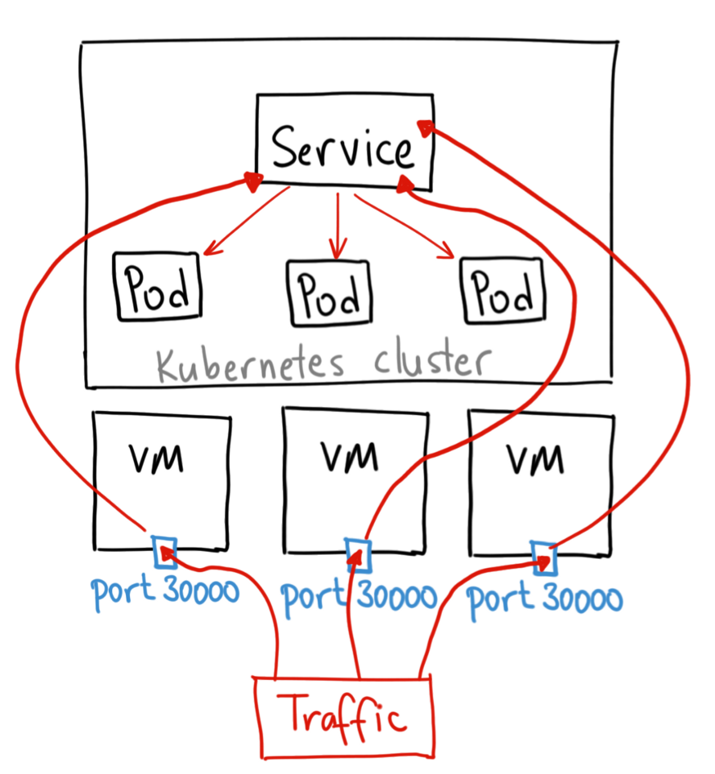
Service: NodePort
NodePort services are accessible outside the cluster.
It creates a mapping of pods to its hosting node/machine on a static port.
NodePort is in range of ports 30000–32767
Kube-Proxy will be listening on Nodeport each Node
Recv. external traffic and forward to cluster IP
apiVersion: v1
kind: Service
metadata:
name: my-nodeport-service
spec:
selector:
app: my-app
type: NodePort
ports:
- name: http
port: 80
targetPort: 80
nodePort: 30036
protocol: TCP
Notes:
https://medium.com/google-cloud/kubernetes-nodeport-vs-loadbalancer-vs-ingress-when-should-i-use-what-922f010849e0
https://stackoverflow.com/questions/39159547/how-is-cluster-ip-in-kubernetes-aws-configured

Slide 34
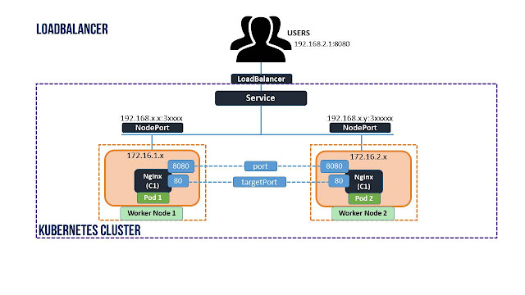
Service: Load Balancer
This service type creates load balancers in various Cloud providers like AWS, GCP, Azure, etc., to expose our application to the Internet.
The Cloud provider will provide a mechanism for routing the traffic to the services.
apiVersion: v1
kind: Service
metadata:
name: my-service
spec:
selector:
app: MyApp
ports:
- protocol: TCP
port: 80
targetPort: 9376
clusterIP: 10.0.171.239
type: LoadBalancer
status:
loadBalancer:
ingress:
- ip: 192.0.2.127
Notes:
https://rinormaloku.com/kubernetes-in-practice-services/

Slide 35
Thanks

Slide 36
Practice:
Write a application and deploy in k8s cluster with NodePort and access from outside with Node IP
Write a application and deploy in k8s cluster with GCP LoadBalancer and access from outside with exposed IP

